Slide 1

Final Project on Departmental Store
By:
Tallam sravan

Slide 2

Introduction
The following presentation is regarding Departmental Store. The dataset consists of 1030 observations with 16 variables. Total (Sales) is the Dependent Variable the rest 15 are Independent Variables.
The dataset is null free and there were no missing values in the dataset.
The data is sorted into 6 different categories: Beverages, Daily Goods, Gadgets, Personal Care, Pet Care and Sports Equipment, based on these products/categories the sales were determined.
We performed various Analysis including EDA, Factorization.
Further created a histogram, bar plot and scatter plot for better data visualization.

Slide 3
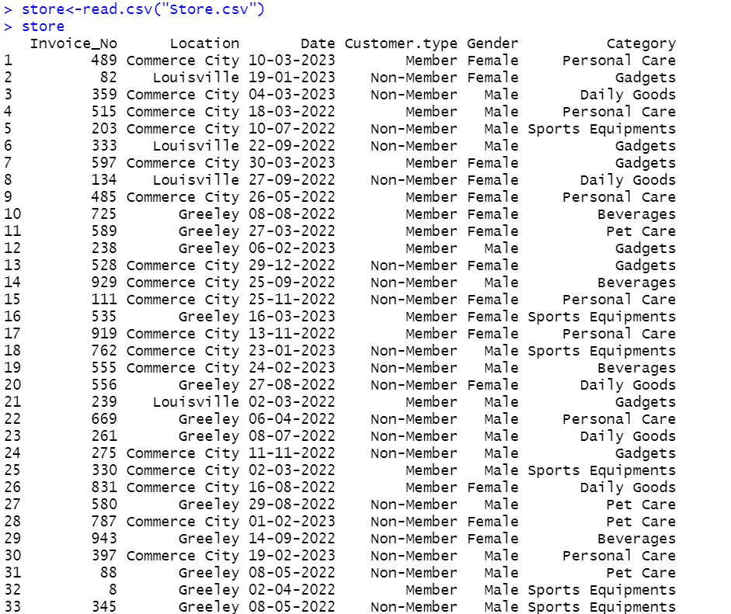
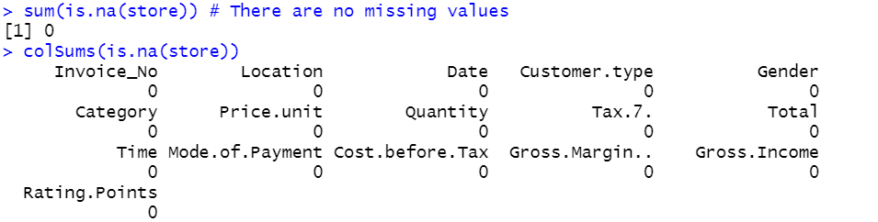
Reading the Dataset and Treating the Missing Values
As a first step we set the working directory and installed and loaded the required libraries. Next, we read the dataset; the dataset consists of 1030 Observations with 16 Variables.
Finding the missing values using is.na and colsums(is.na(store_cleaned_2)). There were no missing values in the dataset.
There were no missing values in the dataset.

Slide 4
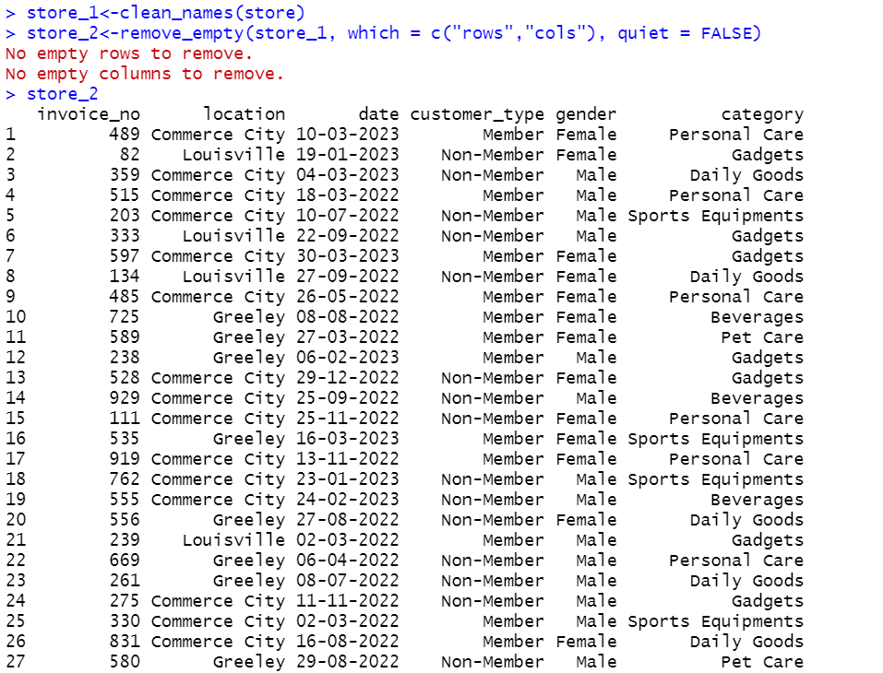
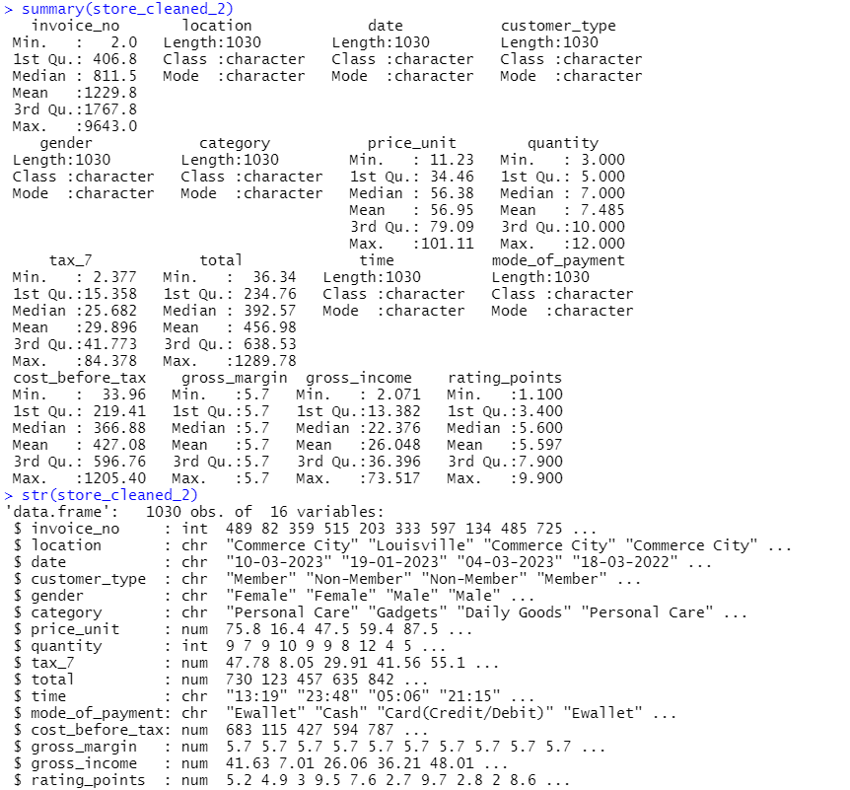
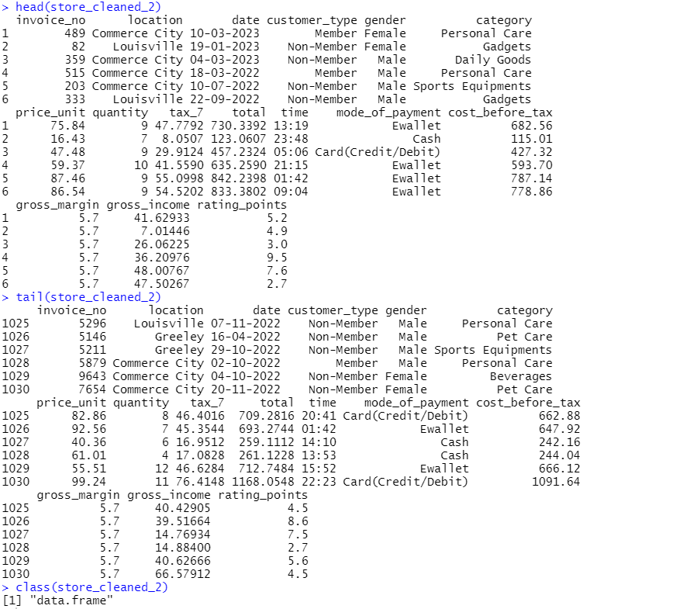
Cleaned Dataset
We cleaned the dataset and named it as store_cleaned_2
Further, summary, str, class, head and tail command on the cleaned dataset (store_cleaned_2); summary command is used to describe the 1st 2nd 3rd quartile along with upper and lower whiskers, str command is used to check what are the datatypes of the variables, class command tells us the datatype (dataframe), head command is used to get the glimpse of first 5 rows with all columns and tail command is used to get the glimpse of last 5 rows with all columns.

Slide 5
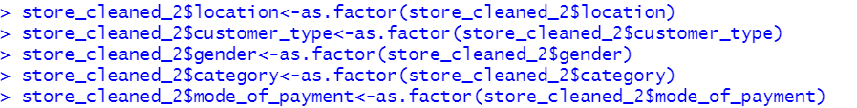
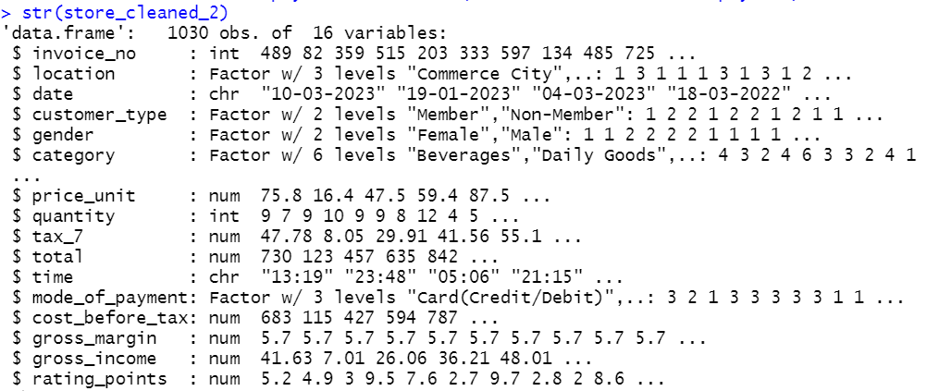
Factorization and str for the cleaned dataset
Factorization for the character variables of the dataset, factorization is generally done to implement the character or categorical variables rightly for model building.

Slide 6
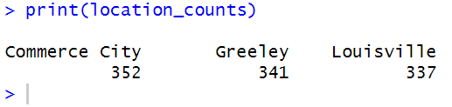
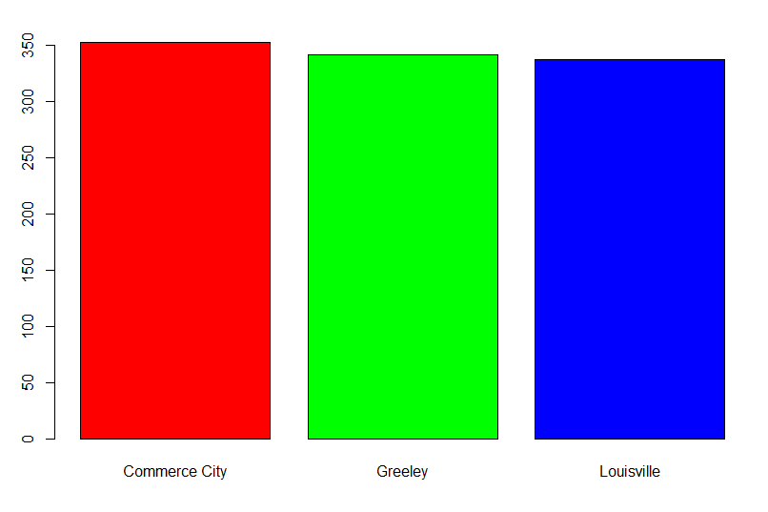
Count Plot
There are a total of 3 Locations in the dataset based on which all the sales are determined; Commerce City, Greeley and Louisville are the three locations.

Slide 7
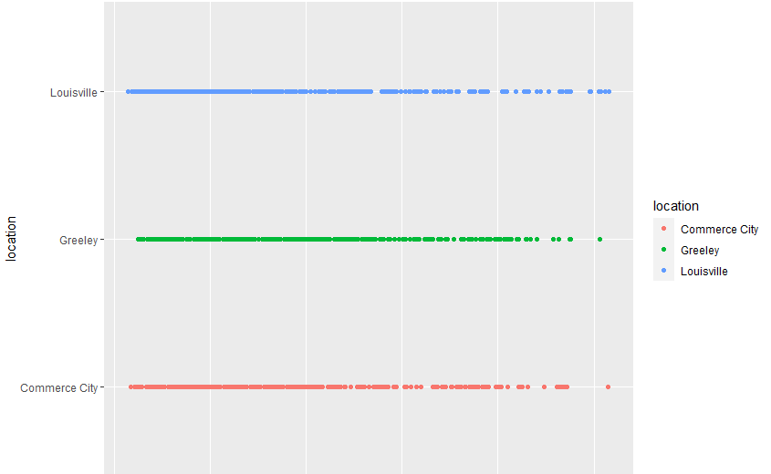
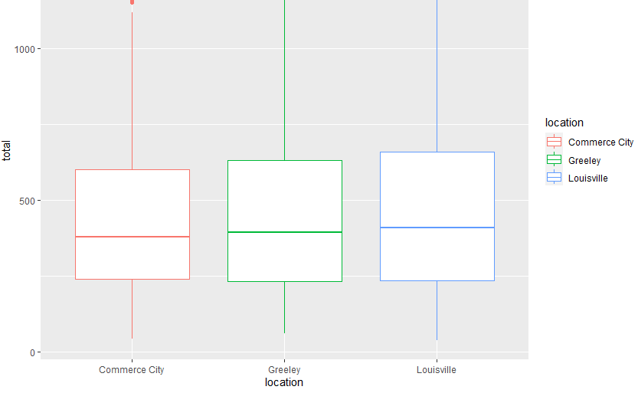
Scatter and Box plots
Below is the First and Second data visualization we created which is a scatter plot and boxplots for Total Sales vs Location. As we observe Commerce City has the highest sales with 352 followed by Greeley with 341 next comes Louisville with 337. All the boxplots for the locations are almost normally distributed and Commerce City and Greeley have a few outliers.

Slide 8
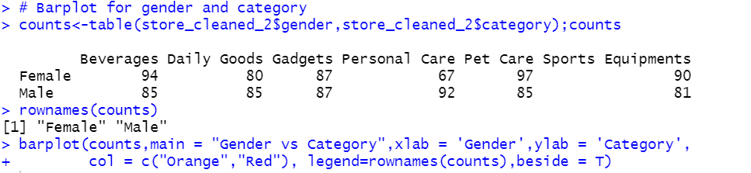
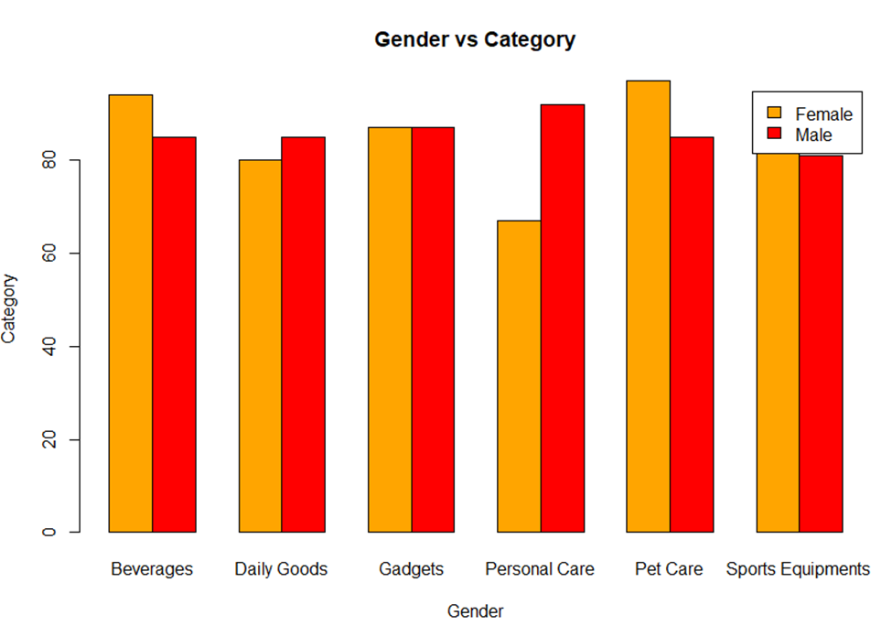
Bar Plot for Gender and Category
The Third data visualization we created is a barplot for gender and category, as we observe there are 6 categories of products; Beverages, Daily Goods, Gadgets, Personal Care, Pet Care and Sports Equipment and two genders. Further, Females are more inclined in buying the Beverages, Pet Care and Sports Equipment, whereas Males often tend to buy Personal Care products and Daily Goods. Gadgets is only type of product where both Males and Females are equal.

Slide 9
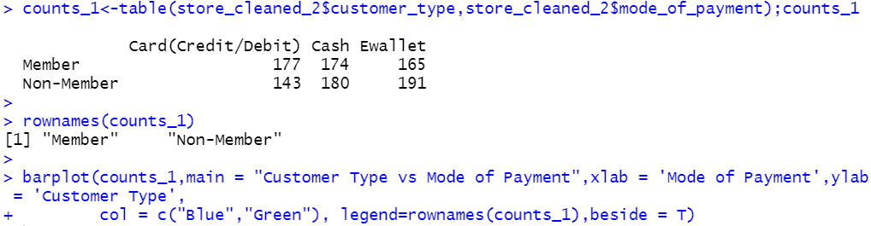
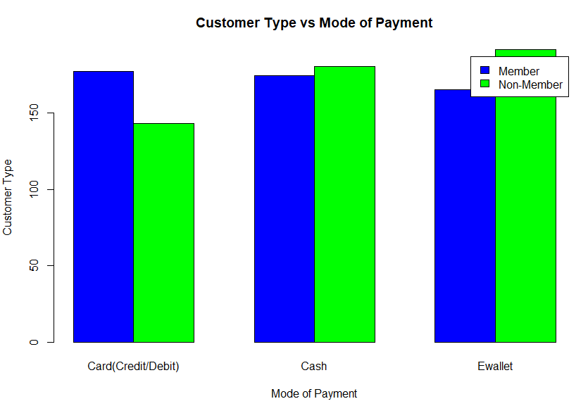
Bar Plot for Customer Type and Mode of Payment
The Fourth data visualization we created is a barplot for customer type and mode of payment, as we observe there are 3 types of payment methods; Card (Credit/Debit), Cash and Ewallet (New Trend). Further, there are two types of customers; Member and Non-member. Irrespective of the customer type most customers prefer to buy their goods via E-wallet, followed by Cash and Card.

Slide 10
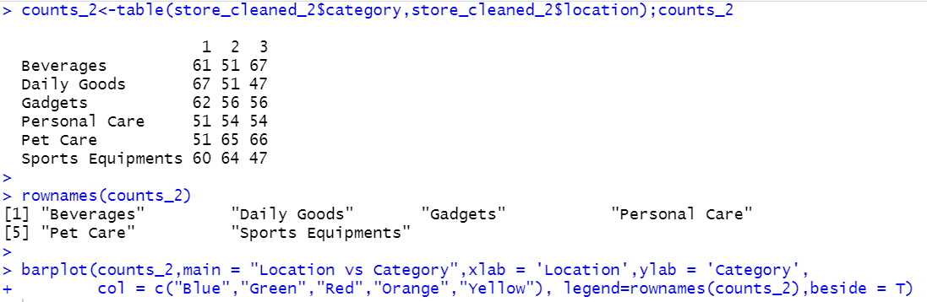
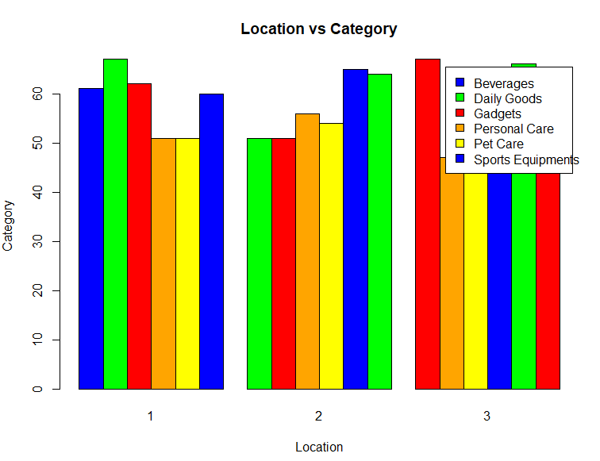
Bar Plot for Location and Category
The Fifth data visualization we created is a barplot for category and location, 6 categories of products; Beverages, Daily Goods, Gadgets, Personal Care, Pet Care and Sports Equipment. Further, there are 3 locations; Commerce City (1), Greeley (2) and Louisville (3). As, we observe Daily Goods in location 1 has the highest sales and least in location 2, Beverages in location 3 has the highest sales and least in location 2 and Sport Equipment has the highest sales in location 2 and least in location 3.

Slide 11
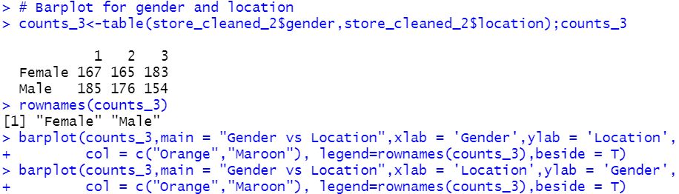
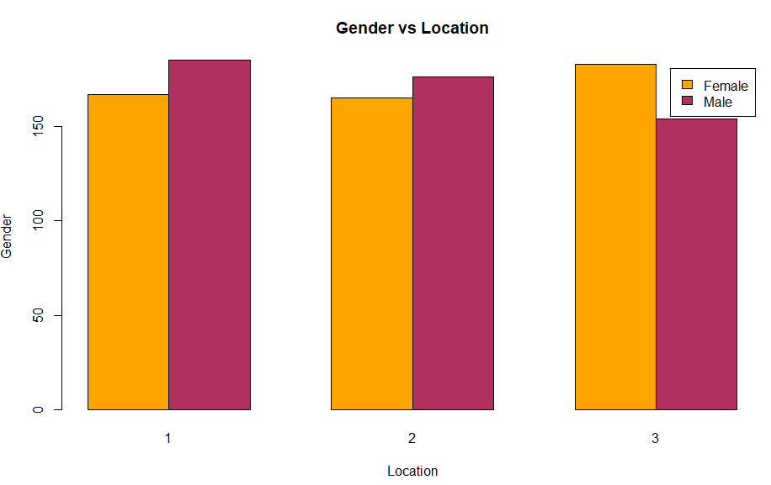
Bar Plot for Gender and Location
The Sixth data visualization we created is a barplot for gender and location. Gender; Male and Female. Further, there are 3 locations; Commerce City (1), Greeley (2) and Louisville (3). We can conclude a few things that most of males visit the location 1 and least at location 2 and most of the females visit the location 3 and least at location 3.

Slide 12
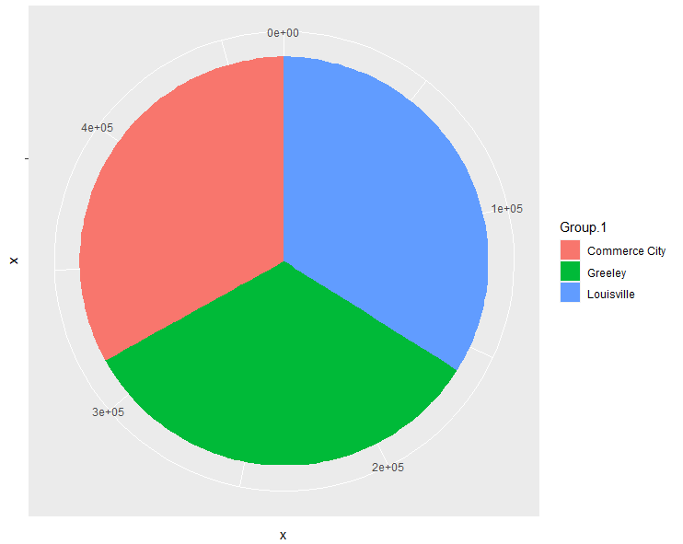
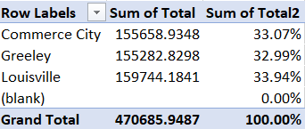
Pie Chart for Total Sales with a Table
The Seventh data visualization is a pie chart which depicts the total percentage of total sales for each Location, as we observe Louisville take up the maximum percentage with 33.94% followed by Commerce City with 33.07% then comes Greeley with 32.99%. A pie chart represents the data in the form of a “pie”; a circular graph. Each pie chart depicts different levels or portions of the data. The whole pie chart is 100%.
The pie chart is followed by a table which displays the percentage of total sales.

Slide 13
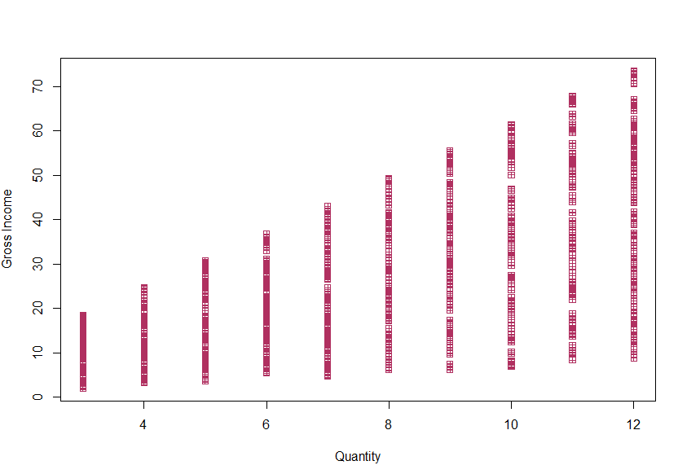
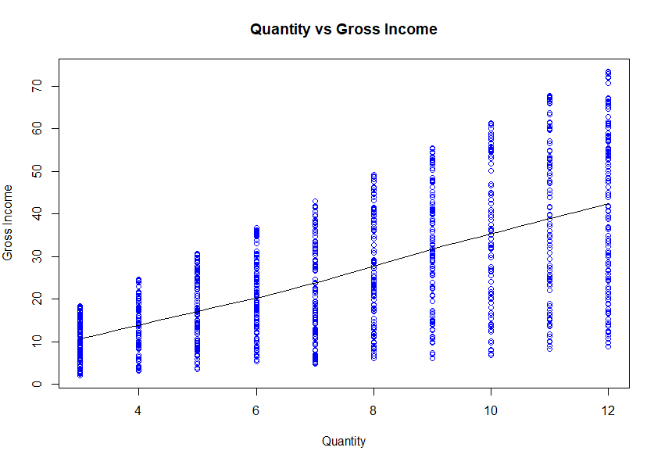
Scatter Plot with Trend Line
The Eight and Last data visualization are two scatter plots; one with normal scatter plot and the other with scatter plot with the trend line. The scatter plot is plotted for Quantity vs Gross Income, there exists a positive relationship between the two, which further means that the gross income increases when the quantity is high.

Slide 14
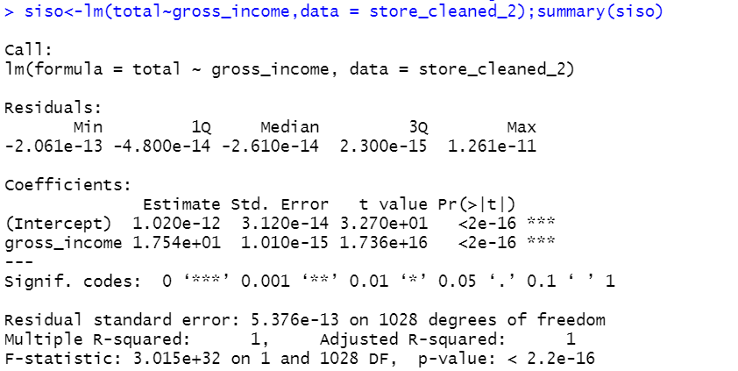
SISO Model
A multiple linear model is a statistical model used to find and analyse the linear relationship between one dependent variables and multiple independent variables. In simple words it’s a regression model which includes two or more predictors.
We first created a SISO Model (Single Input with Single Output) and we got R Square value of 100% and our Adjusted R Square value of same 100%.

Slide 15
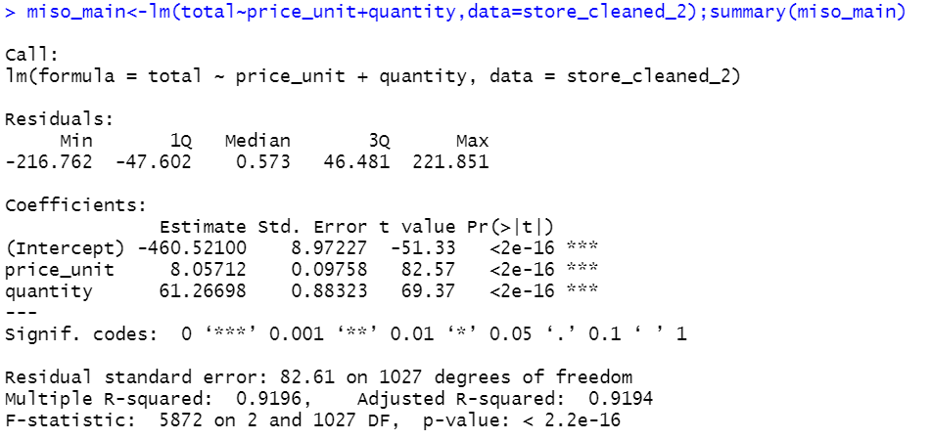
MISO Model
Next, we went on creating a series of MISO Models (Multiple Inputs with a Single Output), we finally selected two MISO models one with the Total (Dependent Variable) and two Independent Variables (Price unit and Quantity). Our next MISO model has the same Dependent Variable with two different Independent Variables (Price unit and Gross Income)

Slide 16
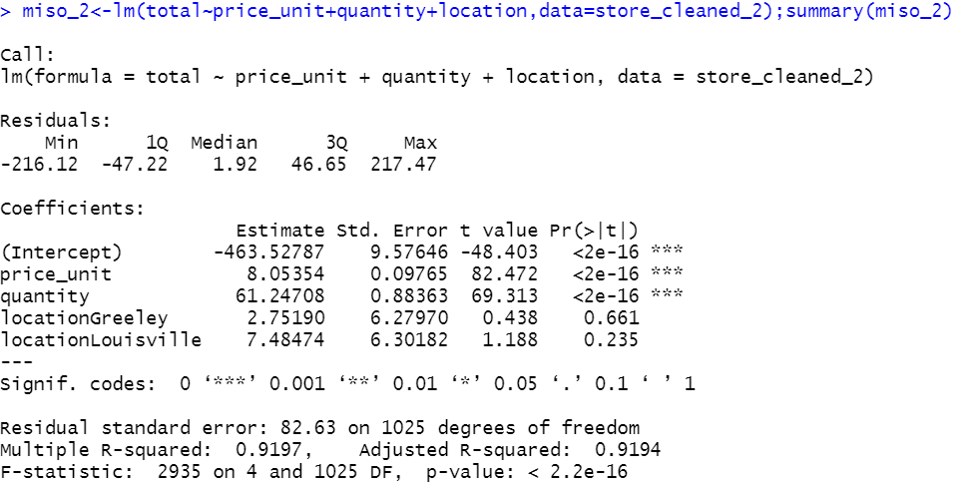
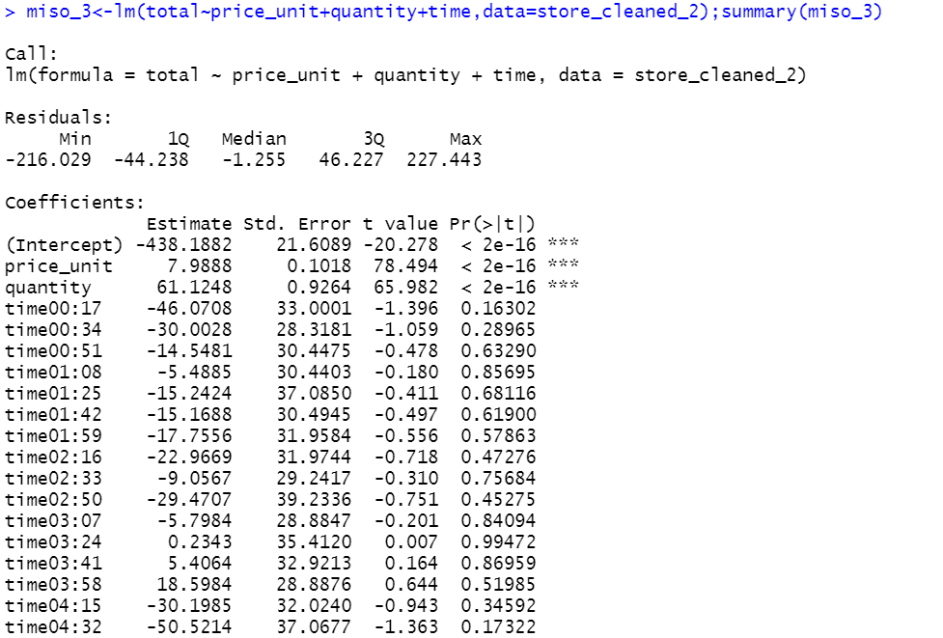
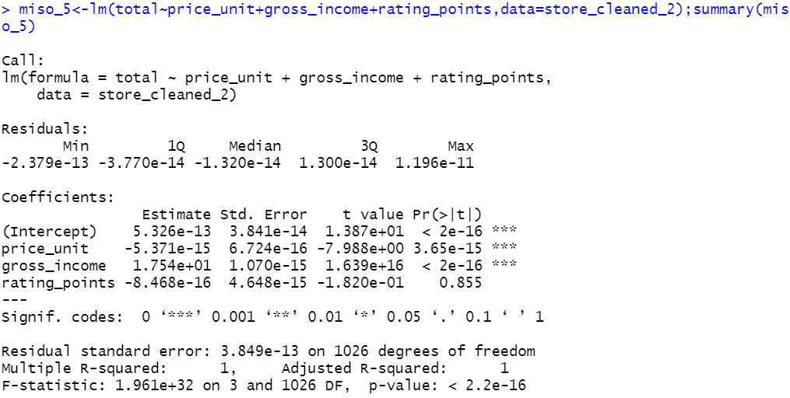
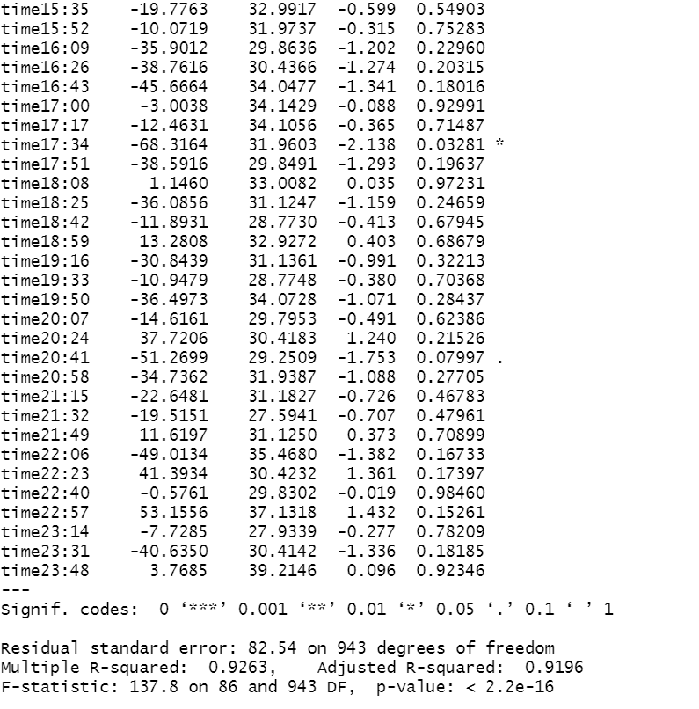

Slide 17
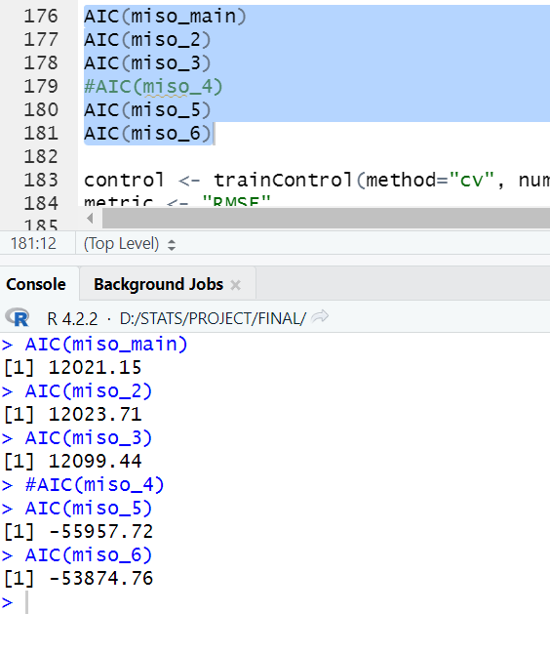

Slide 18
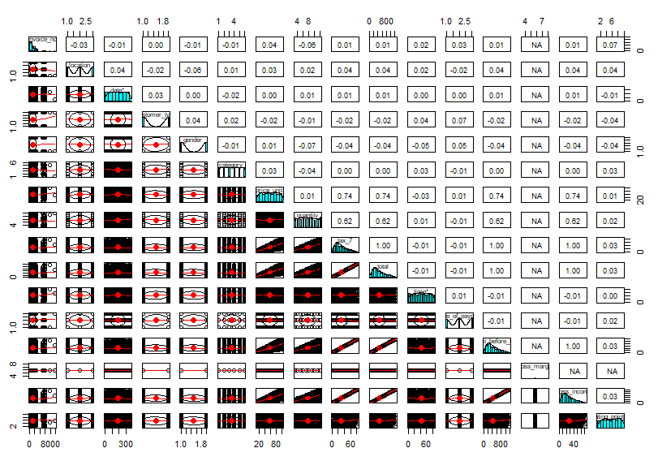
Pairs Plot
We, then plotted a pairs plot for the cleaned dataset (store_cleaned_2), we use the pairs plot to check relationship of each Independent Variable for the Dependent Variable and to understand the clusters. As we observe, most of the plots are right skewed and a few with a different one.

Slide 19
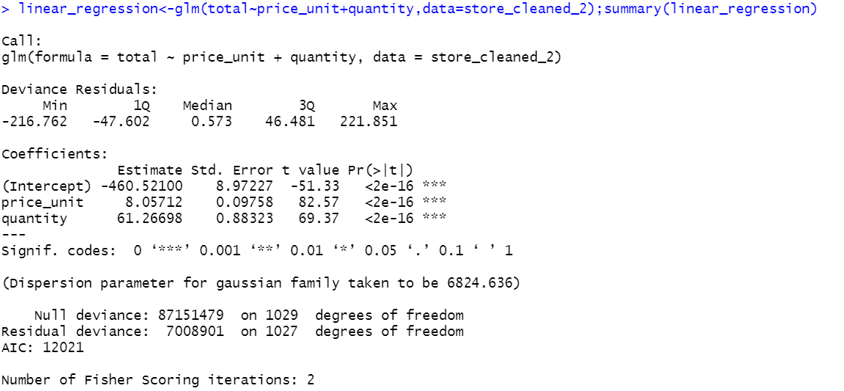
Linear Regression Model
First, we created a Linear Regression Model for the main miso model (miso_main).
When looking at the output of a statistical analysis we used a Gaussian (normal) distribution to model the response variable. The dispersion parameter for the Gaussian family is typically the variance of the response variable. In this case, the dispersion parameter is given as 6824.636.
The null deviance and residual deviance are measures of the goodness of fit of the model. The null deviance represents the total variability in the response variable when no predictors are included in the model. The residual deviance represents the unexplained variability in the response variable after accounting for the predictors in the model. In this case, the null deviance is 87151479 and the residual deviance is 7008901. The difference between the two is used to check the accuracy.
The AIC (Akaike Information Criterion) is a measure of the relative quality of a statistical model for a given set of data. It takes into account both the goodness of fit of the model and the complexity of the model (i.e., the number of parameters). A lower AIC value indicates a better model fit. In this case, the AIC value is 12021, which suggests a relatively good fit of the model to the data.

Slide 20
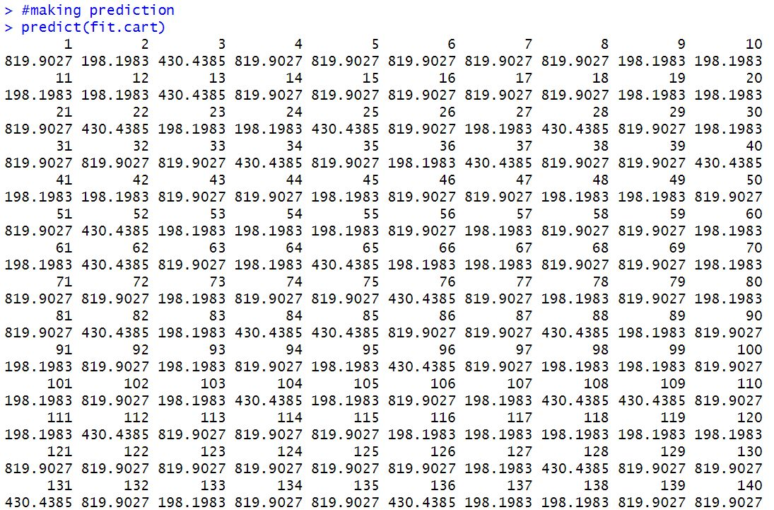
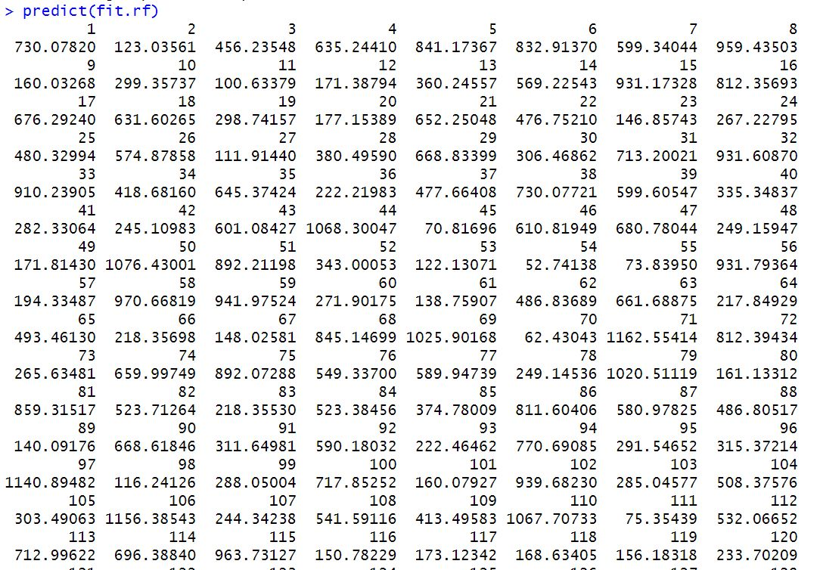
fit.cart <- train(total~., data=store_cleaned_2, method="rpart",metric=metric, trControl=control)
fit.rf <- train(total~., data=store_cleaned_2, method="rf",metric=metric, trControl=control)

Slide 21
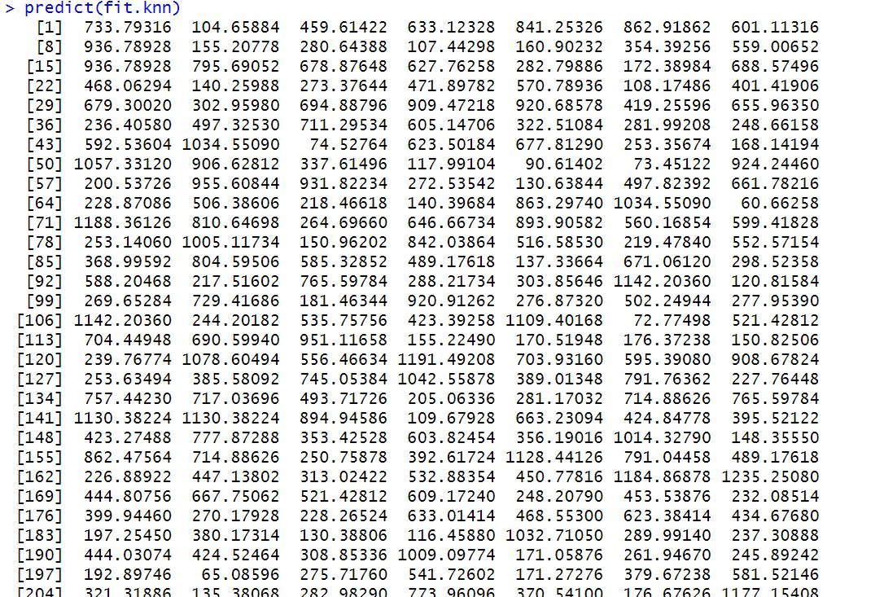
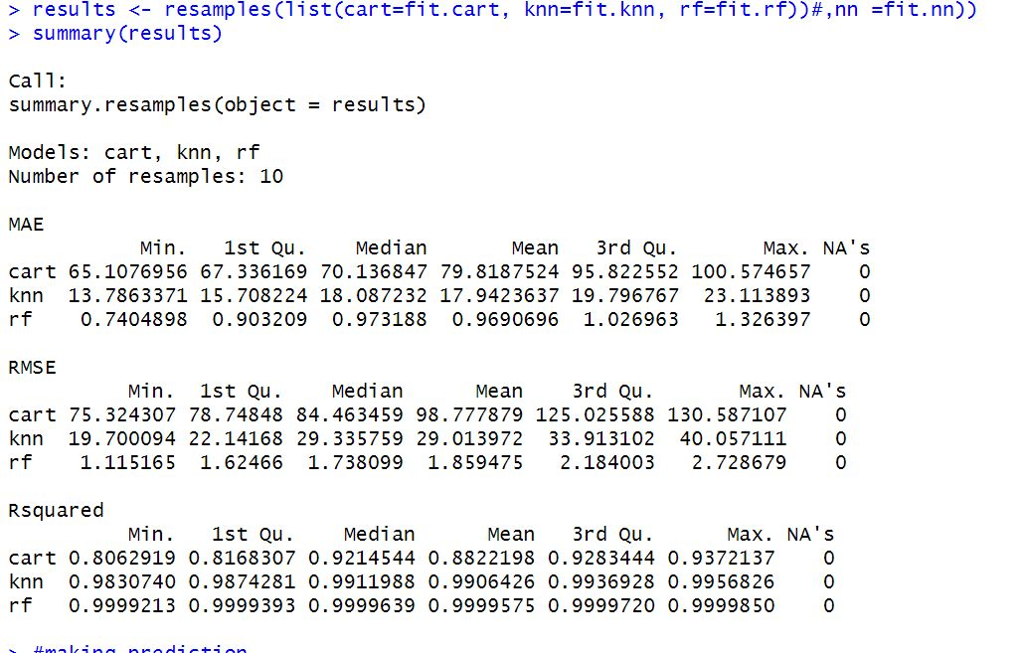
fit.knn <- train(total~., data=store_cleaned_2, method="knn",metric=metric, trControl=control)

Slide 22

Conclusion
Based on our Analysis we conclude that the sales for the departmental store will eventually increase and we believe that the demand and supply for the Goods and Services will be at large.
Further, we suggest the Departmental Store to try focus on marketing the products and shipping and distributing the same equally across all the Locations.
The Departmental Store should also focus on Hiring the Employees and also try to make changes to the existing products by segregating the same products according to the demands of the public.
At last, we conclude that the Departmental Store will run good business once they start targeting the Customer policies and concentrate on increasing sales of different categories.

Slide 23

Thank you

